Slide 1
CPG adaptation
이 유 경
순천향대학교 의과대학 진단검사의학교실 / 대한의학회 임상진료지침 전문위원

Slide 2
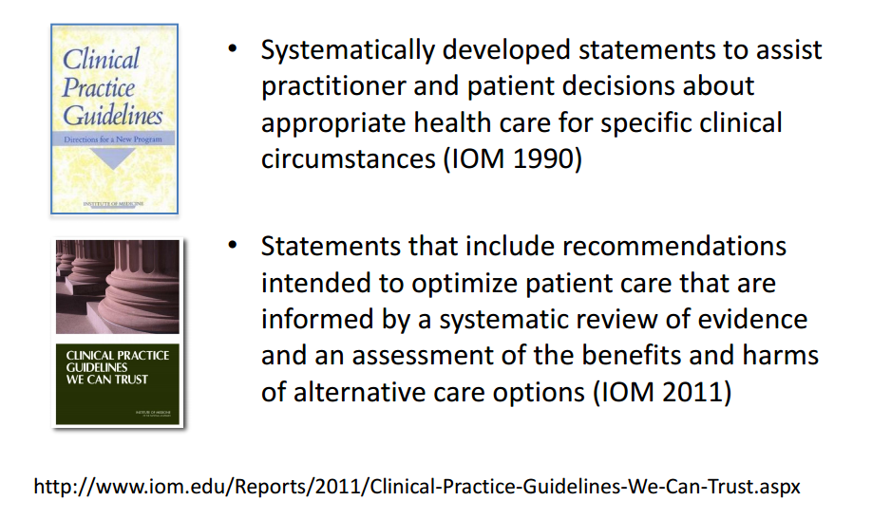
임상진료지침(Clinical practice guideline)
임상진료지침의 정의
보건의료 제공자의 의사결정에 도움을 주기 위해 과학적 근거를 검토하여 체계적으로 개발된 권고와 관련 내용을 기술한 것
- 김수영 등 2009 -

Slide 3

Why CPG...
Authority

Slide 4
CPG, to be trustworthy…
Evidence base
Be based on a systematic review of the existing evidence;
Provide a clear explanation of the logical relationships between alternative care options and health outcomes, and provide ratings of both the quality of evidence and the strength of recommendations; and
Transparency (or Legitimacy)
Be developed by a knowledgeable, multidisciplinary panel of experts and representatives from key affected groups;
Consider important patient subgroups and patient preferences as appropriate;
Be based on an explicit and transparent process that minimizes distortions, biases, and conflicts of interest;
Currency (or updating)
Be reconsidered and revised as appropriate when important new evidence warrants modifications of recommendations.
Clarity

Slide 5
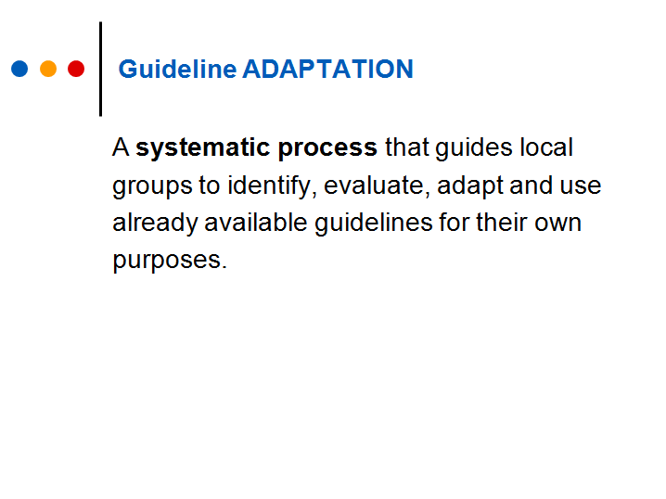
인용: CAN-IMPLEMENT©

Slide 6
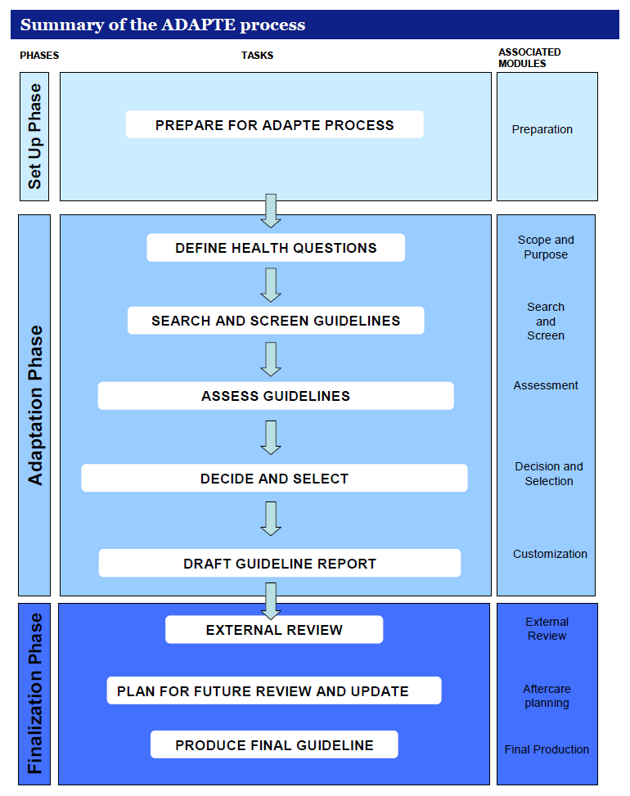
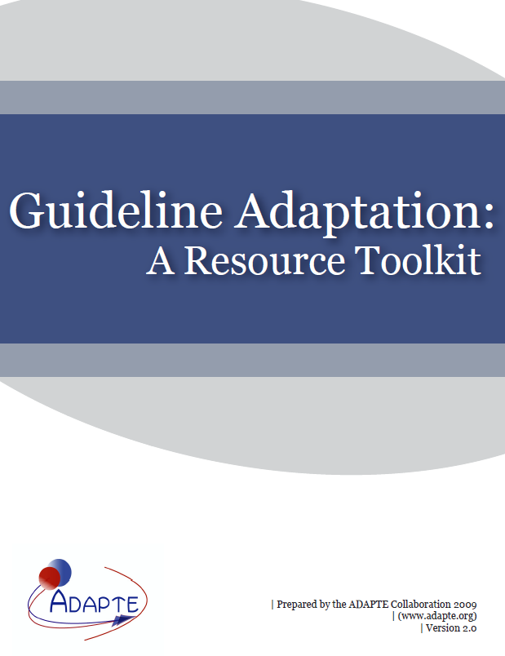
ADAPTE process

Slide 7
de novo
Adaptation
Consensus meeting
CORE search
RoB, ROBANS, QUADAS, Amstar
CORE
+
NGC, SIGN, NICE, GIN, WHO, NHMRC
AGREE 2
계획: 목적, 범위, 핵심질문
개발방법 결정
근거탐색 (Database)
근거의 선택과 평가
권고안 생성/집필
근거자료의 고찰
Evidence synthesis
Content, consistency, currency,
applicability , acceptability
Updating evidence
Consensus process
Consensus process
내부/외부검토
핵심검토결과의 반영
내부/외부검토
핵심검토결과의 반영
인증, 출판, 보급
권고안 실행의 모니터링
인증, 출판, 보급
권고안 실행의 모니터링
검토/지침확정
인증/보급
Consensus process
내부/외부검토
핵심검토결과의 반영
인증, 출판, 보급
권고안 실행의 모니터링

Slide 8
de novo
Vs
adaptation

Slide 9
질문부터 던지고….
CQs
1단계: unstructured questions
2단계: PICO 고려하여 구조화 (핵심임상질문)
Preliminary Search
방법 결정
CPGs
1단계:
CPGs의 핵심질문 (혹은 recommendations) list-up
2단계:
정해진 CQs와 비교
1) CQs에 해당하는 내용이 이미 존재
3) CQs 없음
(A) Adaptation without modification
(B) Adaptation with modification
2) CQs 존재하나, 오래된 CPG
최신 자료 검색 및 SR 진행
최신 자료 검색 및 SR 진행

Slide 10
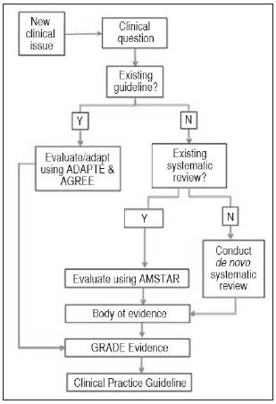
Kaiser Permanente’s process for guideline development
Transparency Matters: Kaiser Permanente’s National Guideline Program Methodological Processes
The Permanente Journal/ Winter 2012/ Volume 16 No. 1

Slide 11
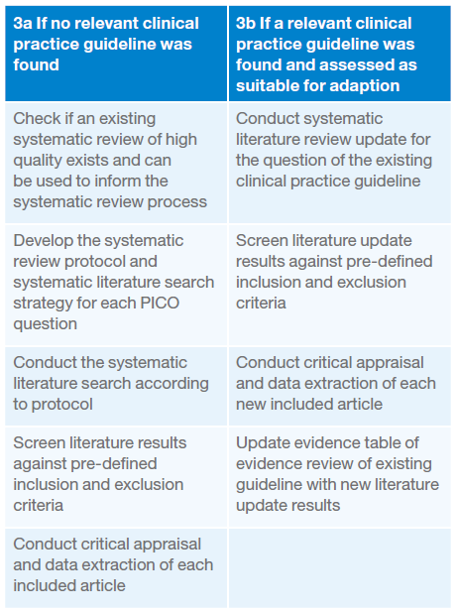
NHMRC, Australia
PICO question
Search for existing relevant guidelines and systematic reviews
De novo / adaptation
Summarize the relevant data
Meta-analysis (필요시)
Assess the body of evidence and formulate recommendation
Write the content narrative

Slide 12
Adaptation: 기존 진료지침 수용 개발
기획
주제선정
Feasibility 탐색
개발
KQs
권고초안 작성
최종화
External review by target users
Consult
조직구성
Skills & resources 탐색
프로토콜 작성
Adaptation process
Clinical questions
PICO questions
ADAPTE (or modification)
후속관리 계획수립
relevant endorsement bodies
developers of source guidelines
최종 편집

Slide 13
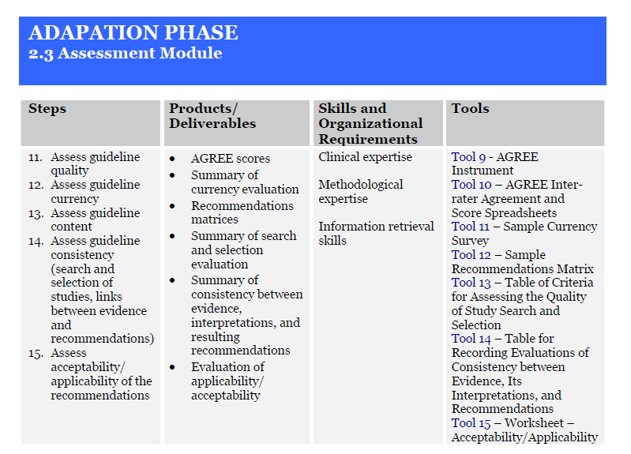
출처 : Guideline Adaptation: A Resource Toolkit, ADAPTE

Slide 14
국내 사례
임상영상가이드라인

Slide 15
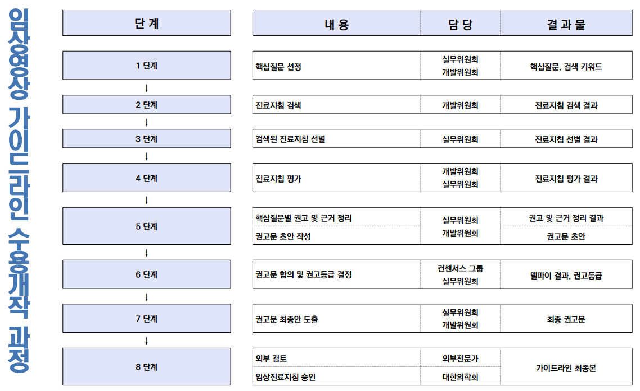
임상영상 가이드라인 개발 adaptation process

Slide 16
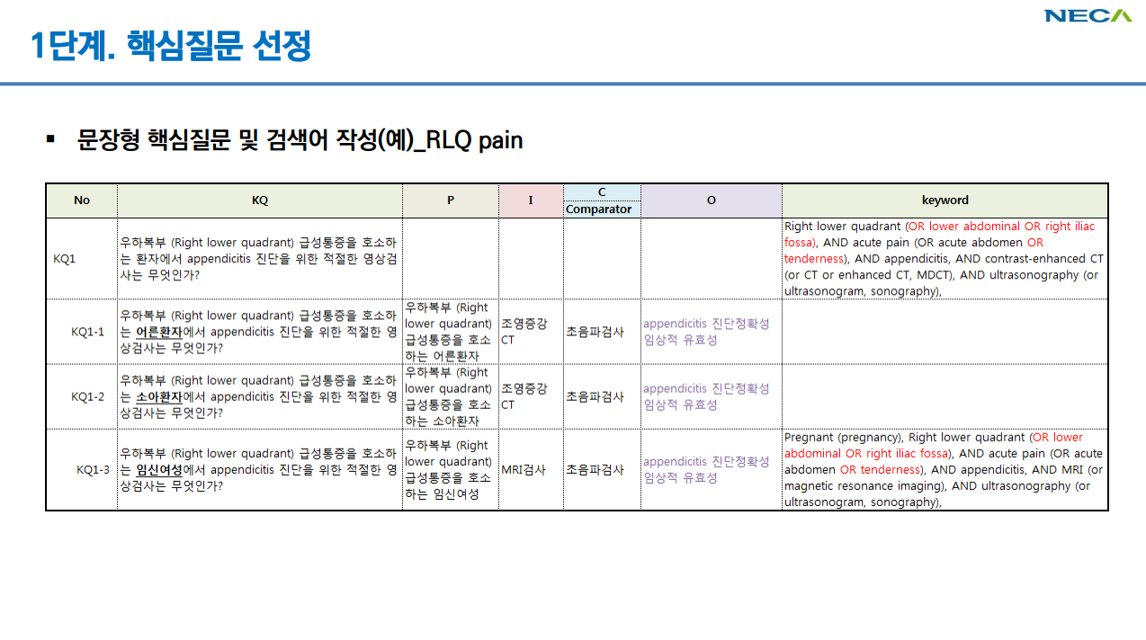

Slide 17
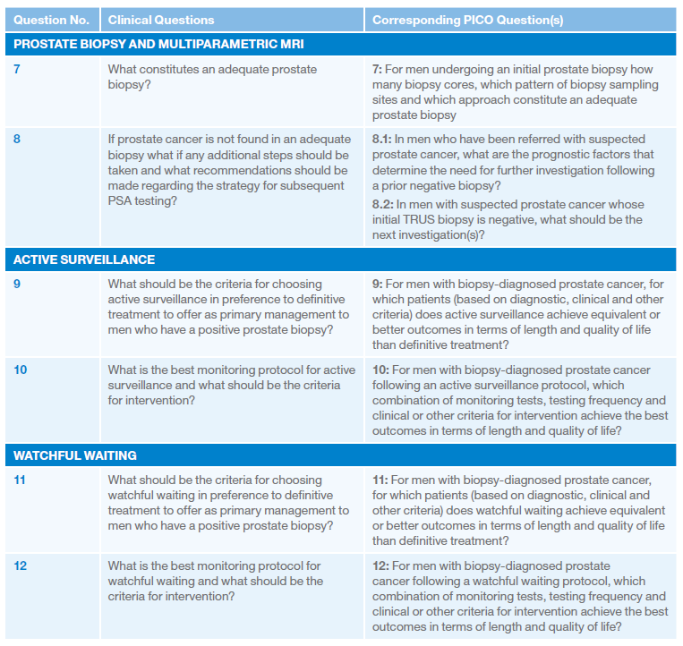

호주 NHMRC 2016

Slide 18
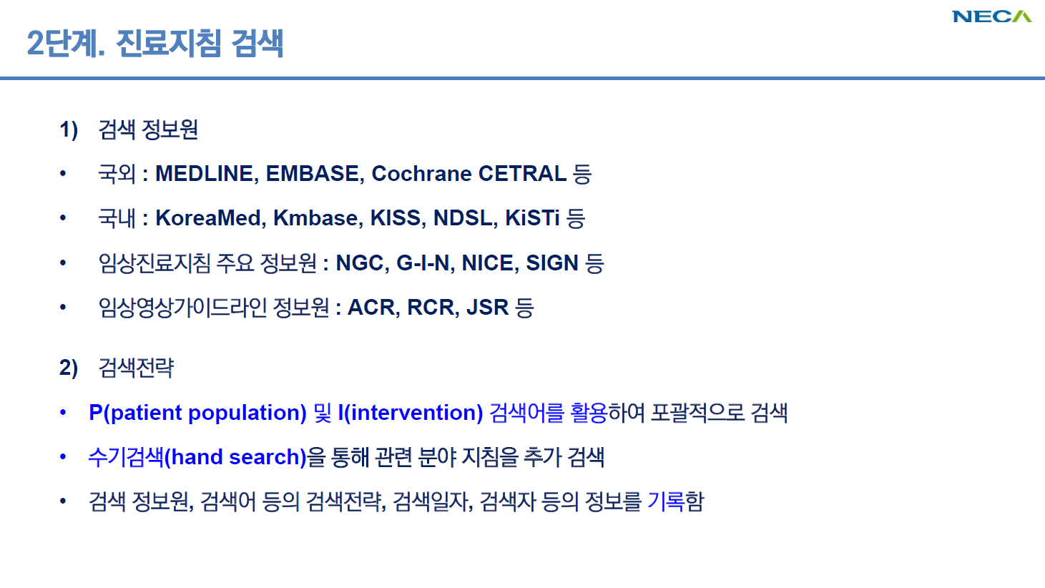

Slide 19
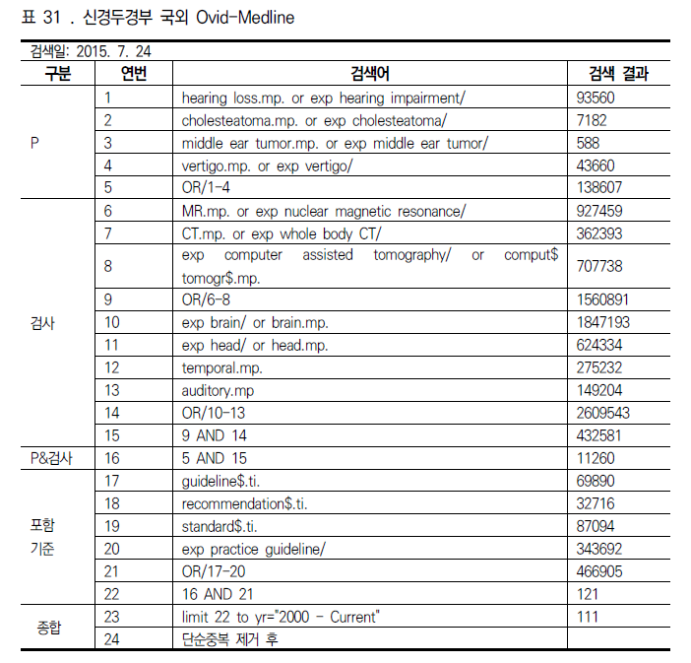
Adaptation: 검색 예

Slide 20
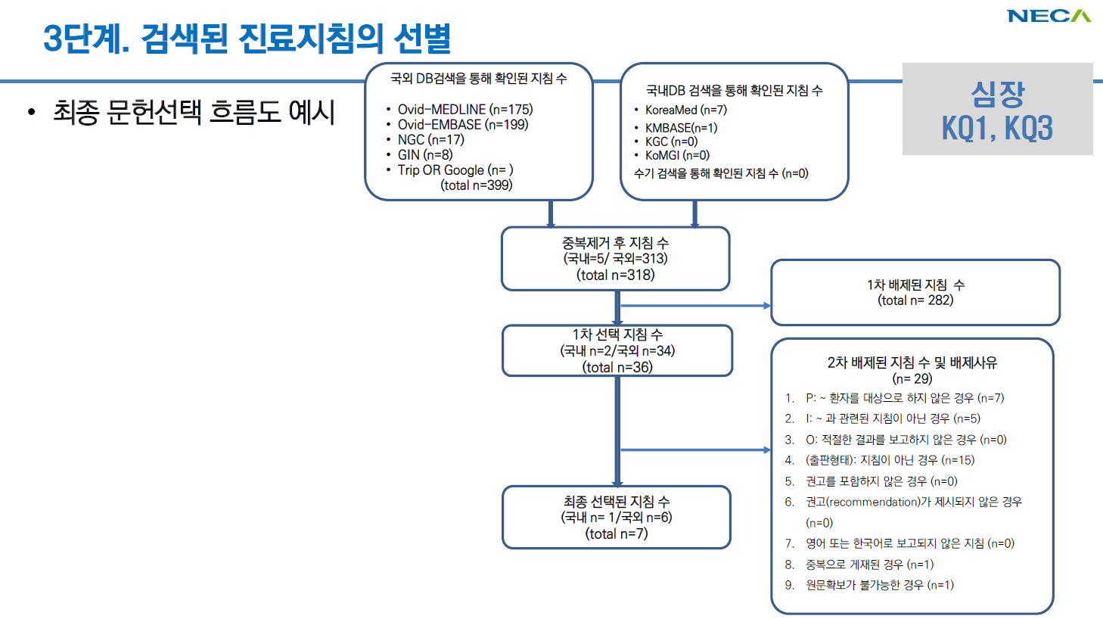

Slide 21
평가와 선별
- 기존 임상진료지침 질평가
- 기존 권고안 검토

Slide 22
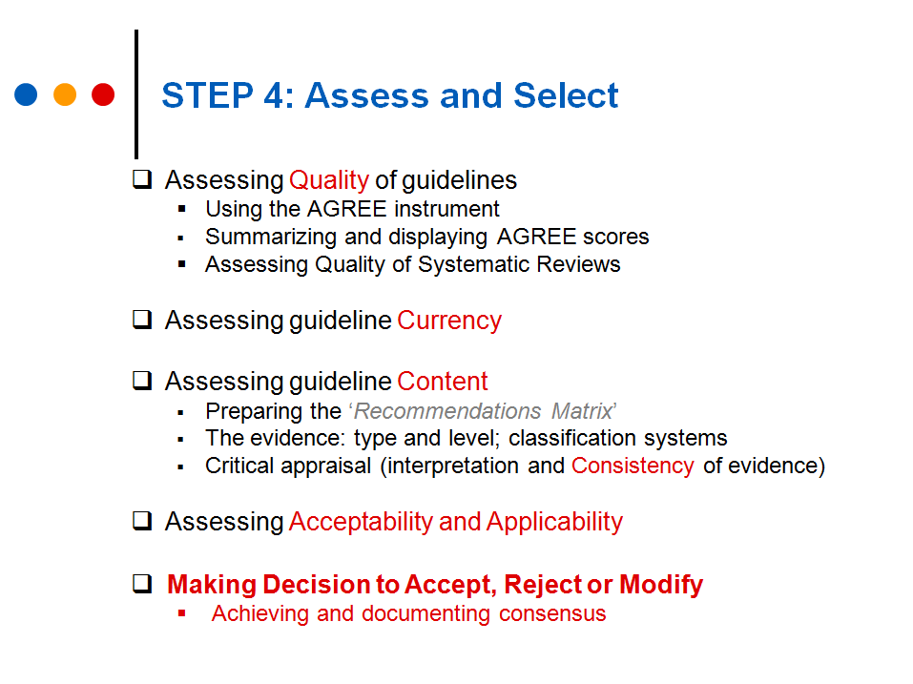
인용: CAN-IMPLEMENT©

Slide 23
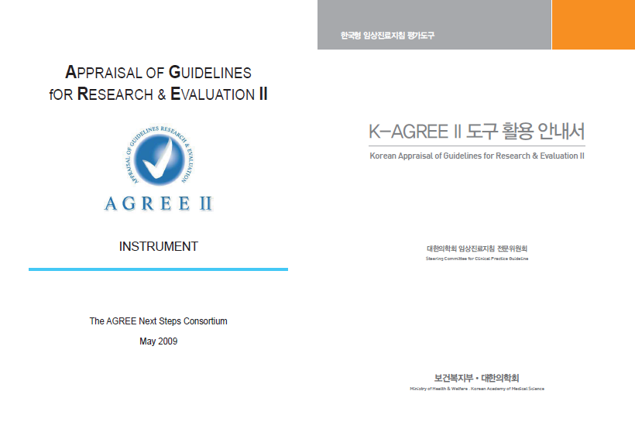
구성: 6 평가영역 23 문항
영역 (domains)
범위와 목적 (3)
이해당사자의 참여 (3)
개발의 엄격성 (8)
표현의 명확성 (3)
적용성 (4)
편집의 독립성 (2)

Slide 24
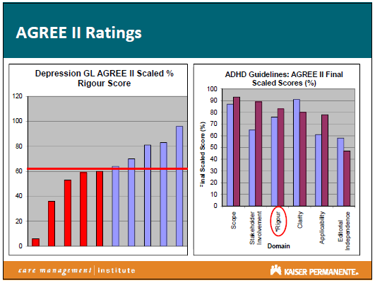
Adapting External Depression and ADHD Clinical Practice Guidelines (CPGs)
Kaiser Permanente, USA

Slide 25
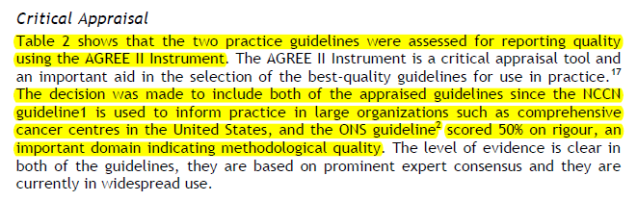
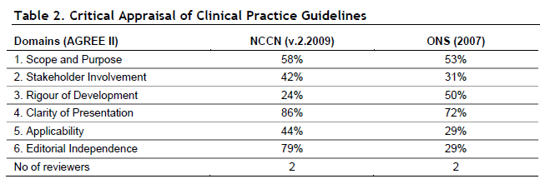
A Pan-Canadian Practice Guideline: Screening, Assessment and Care of Cancer-Related Fatigue in Adults with Cancer
Canada

Slide 26
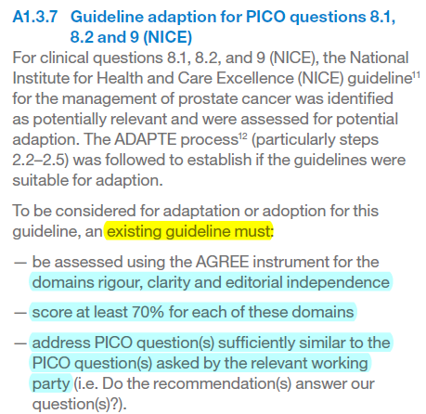
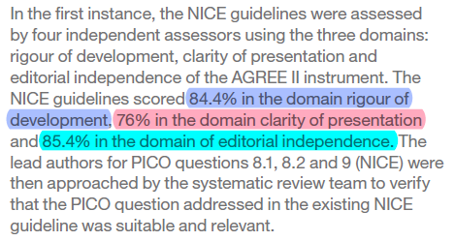
Prostate Cancer Foundation of Australia and Cancer Council Australia PSA Testing Guidelines Expert Advisory Panel. Draft clinical practice guidelines for PSA testing and early management of test-detected prostate cancer. Prostate Cancer Foundation of Australia and Cancer Council Australia, Sydney (2016).

Slide 27
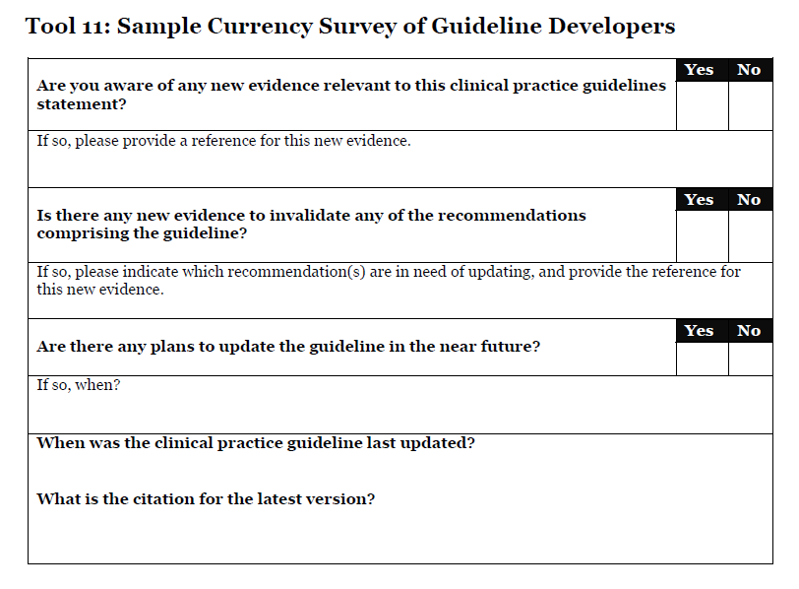
최신성 (currency)
출처 : Guideline Adaptation: A Resource Toolkit, ADAPTE

Slide 28
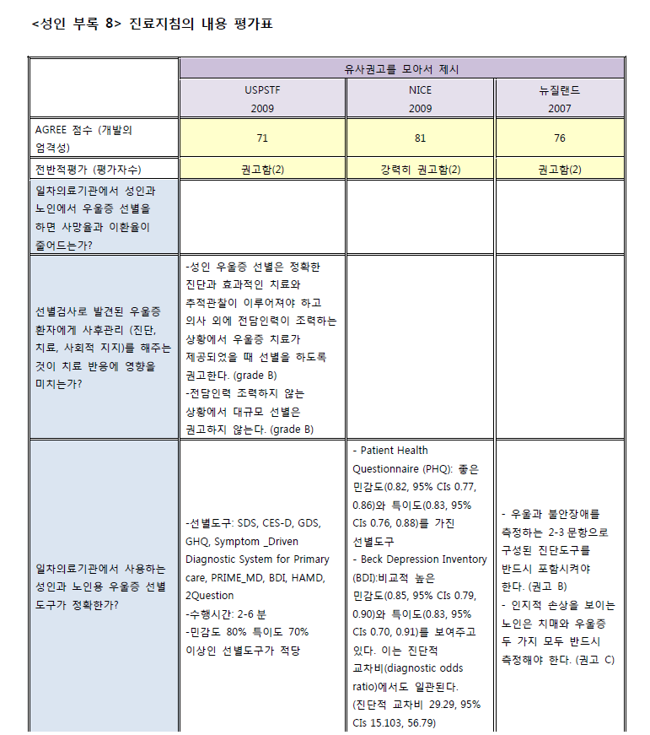
내용정리 평가 (content)-1
Recommendation matrix
근거 검토 평가
일관성 평가
출처 : 일차의료기관에서 우울증 선별에 관한 진료지침

Slide 29
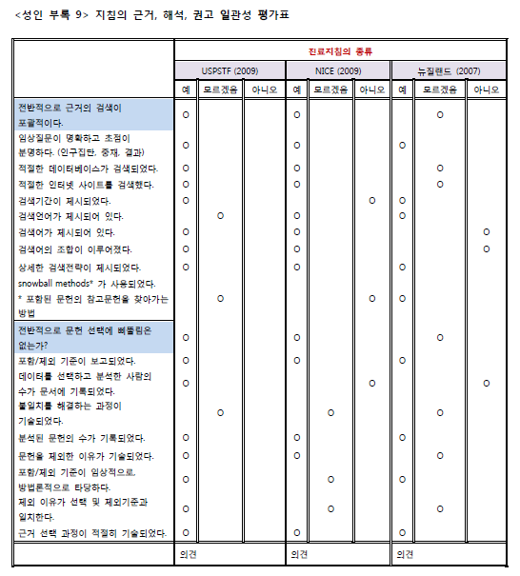
내용정리 평가 (content)-2
Recommendation matrix
근거 검토 평가
일관성 평가
출처 : 일차의료기관에서 우울증 선별에 관한 진료지침

Slide 30
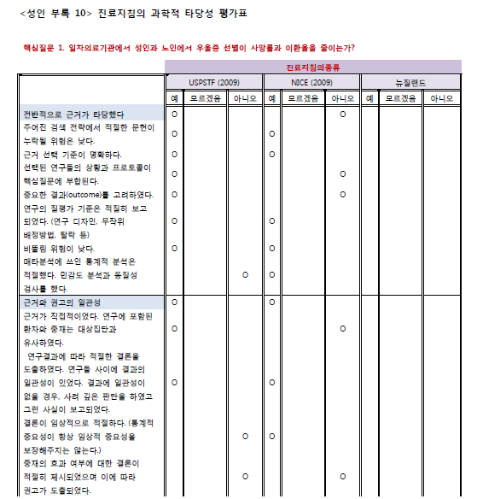
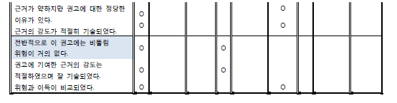
내용정리 평가 (content)-3
Recommendation matrix
근거 검토 평가
일관성 평가
출처 : 일차의료기관에서 우울증 선별에 관한 진료지침

Slide 31
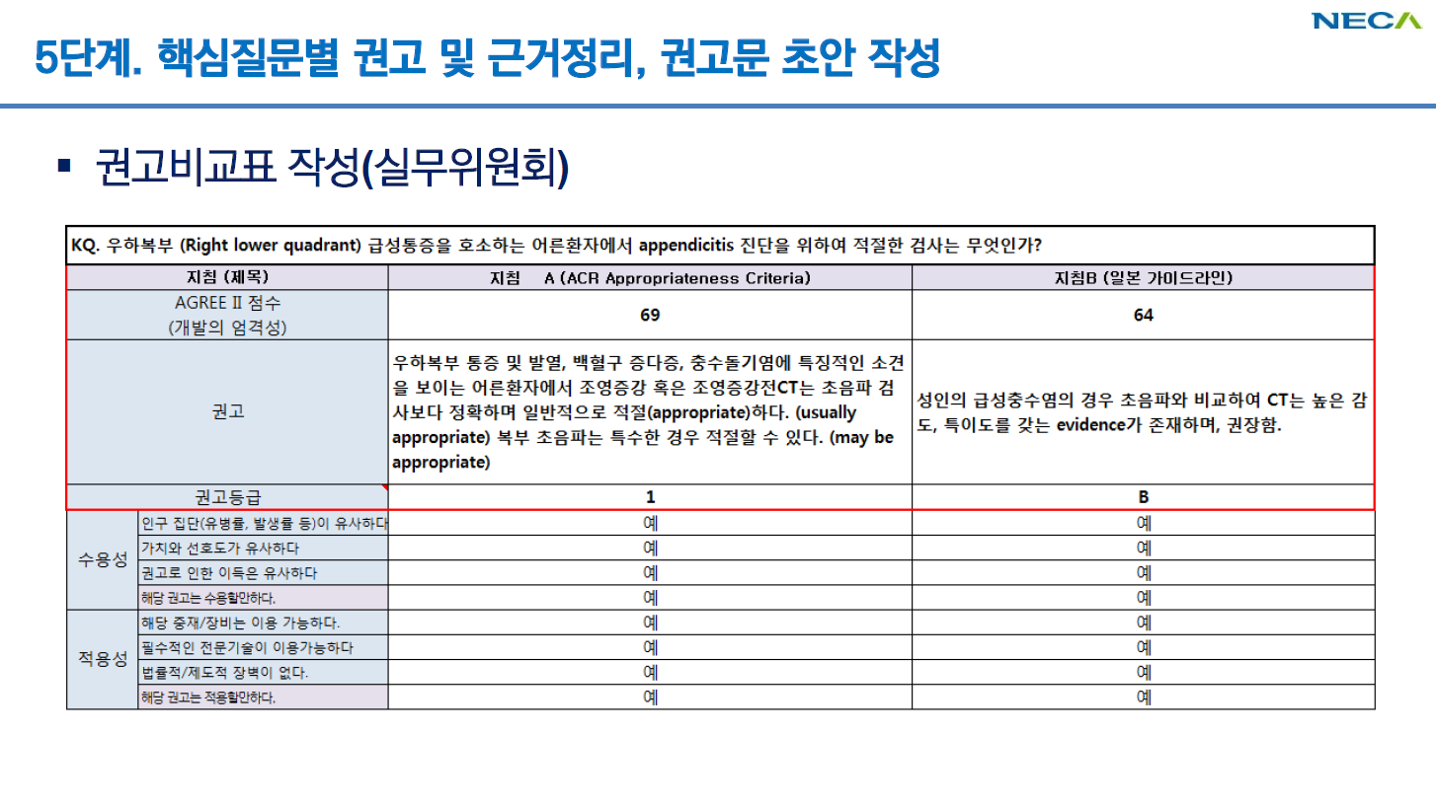

Slide 32
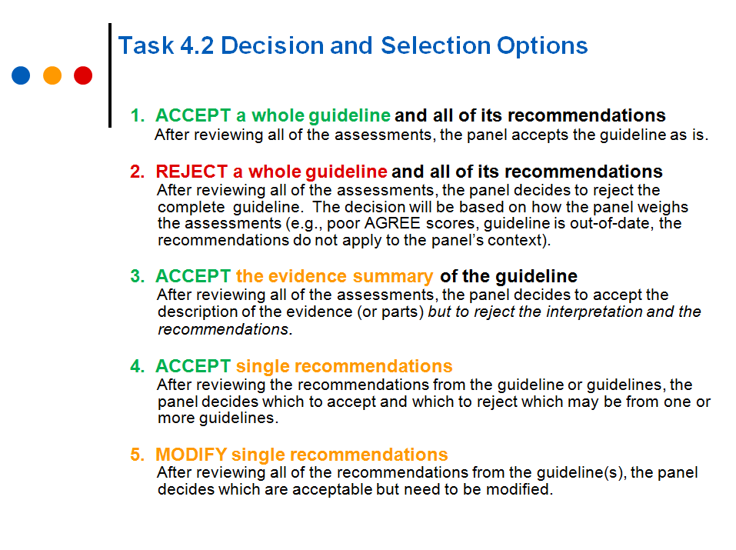
정리하고 평가 완료했는데….
인용: CAN-IMPLEMENT©

Slide 33
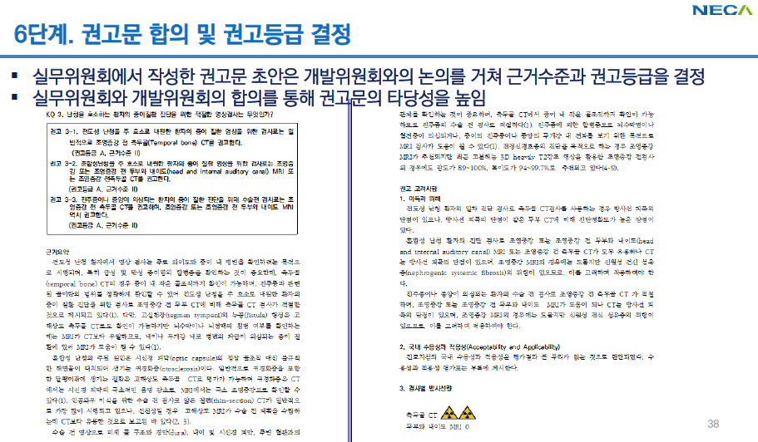

Slide 34
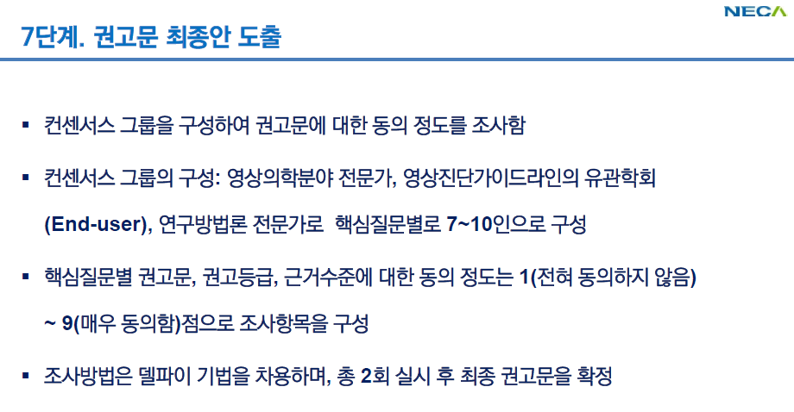

Slide 35
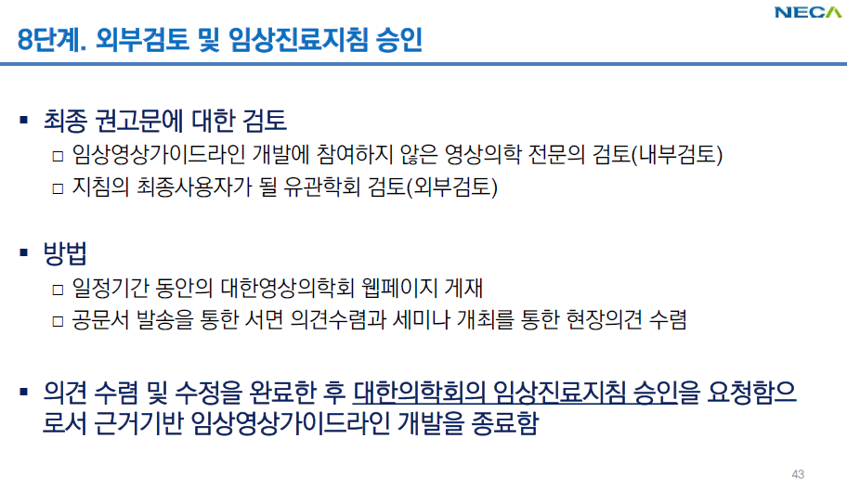

Slide 36
Adaptation 사례

Slide 37
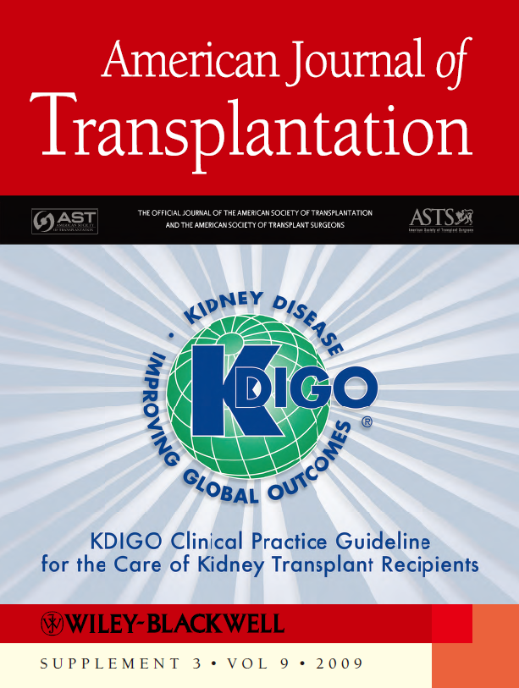
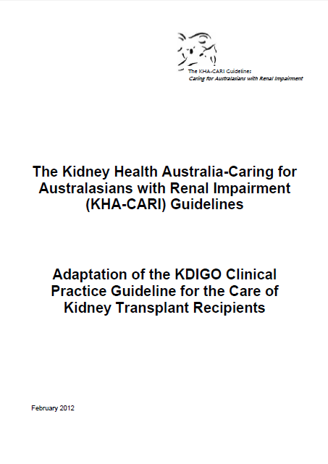

Slide 38
 | KDIGO, 2009 | KHA-CARI, 2012
개발국가 | 미국 | 호주
개발방법 | De novo | Adaptation of KDIGO 2009
근거검색 DB | Medline Cochrane Central Registry for trials Cochrane database of systematic review | 단일 지침 수용개발. 연구문헌 검색 DB는 KDIGO 2009와 동일
검색전략 | 주제별 PICO 제시(table 32). 검색식 제시하지 않음. Cochrane Renal Group이 검색에 참여하였다고 본문에 명시함. | 단일 지침 수용개발. 최신 연구문헌 추가 검색 시행. 검색전략은 KDIGO 2009와 동일.

Slide 39
 | KDIGO, 2009 | KHA-CARI, 2012*
근거수준과 권고 강도 | 동일 원칙 적용
권고안 비교 | Chapter 1. Induction Therapy
 | 1.1: We recommend starting a combination of immunosuppressive medications before, or at the time of, kidney transplantation. (1A) | a. We recommend that a combination of immunosuppressive medications start before, or at the time of, kidney transplantation. (1A)
 | 1.2: We recommend including induction therapy with a biologic agent as part of the initial immunosuppressive regimen in KTRs. (1A) | b. We recommend induction therapy with a biologic agent as part of initial immunosuppression in kidney transplant recipients. (1B)
 | Not addressed | g. We suggest that patients undergoing ABO incompatible transplantation should undergo plasmapheresis or immunoadsorption to reach an anti-blood group titre known to be acceptable at that institution with consideration of post-transplant antibody removal depending on the baseline titre. (2A)
근거의 요약 | 연구문헌을 요약함. | KDIGO guideline을 토대로 수용개발과정에서 수행된 검토소견을 추가하여 작성하였음을 서두에 명시함.
* KHA-CARI, 2012; KDIGO 2009에 비하여 권고안이 추가됨. 이에 대하여 KDIGO에서는 없는 권고안이 추가된 배경을 아래의 예와 같이 본문에 서술함. The KDIGO guideline did not address induction therapy for patients at high risk of AbMR (ABO blood group incompatible transplants and patients with donor specific antibody and/ or positive cross match), or rituximab. Information regarding these therapies has been included in this guideline, as such transplants are being performed with increasing frequency and are therefore applicable to local practice.

Slide 40
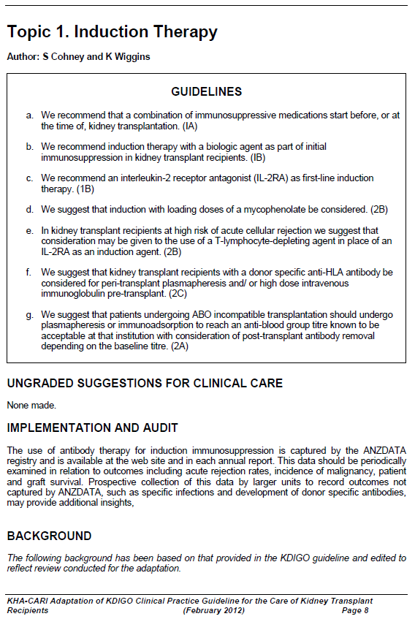
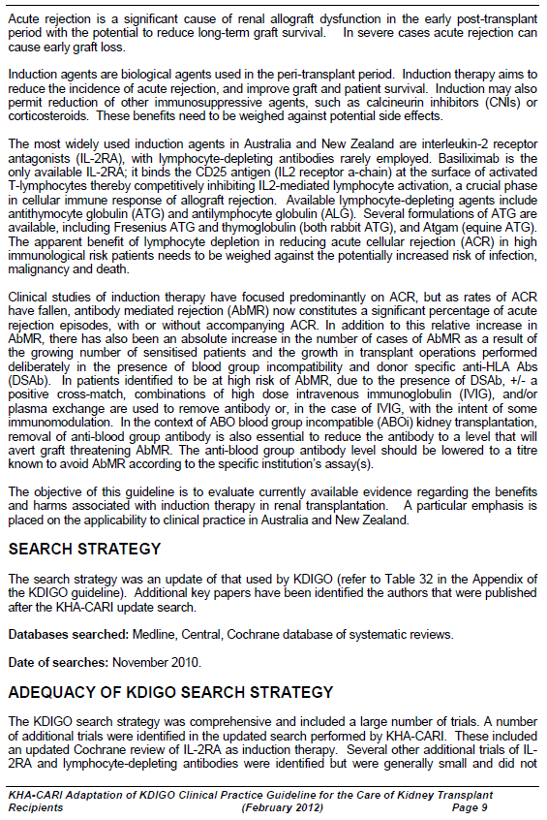
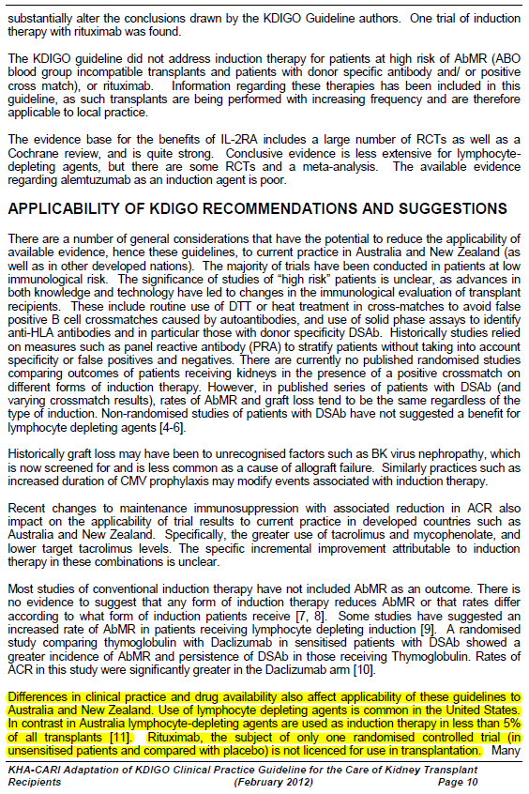

Slide 41
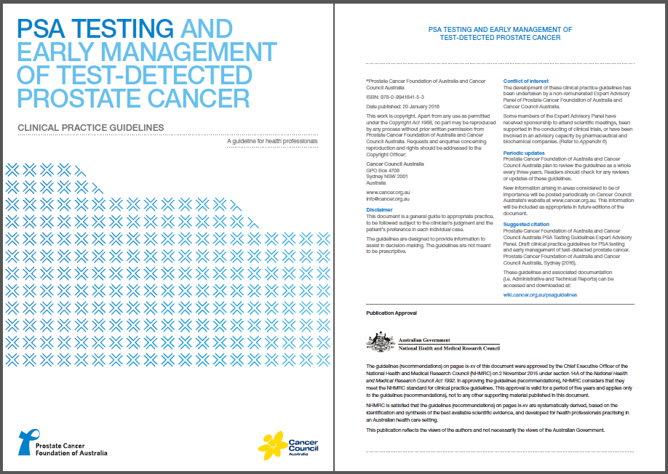

Slide 42
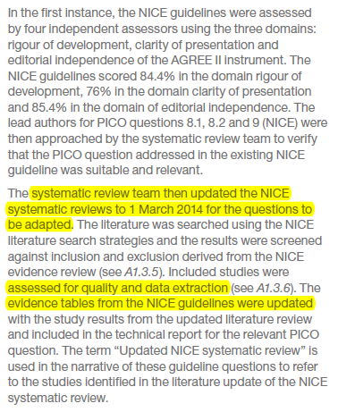
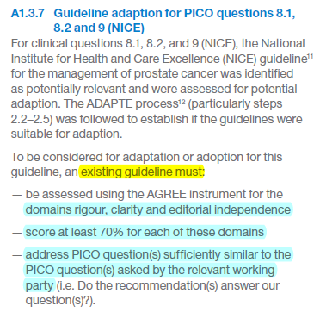
Prostate Cancer Foundation of Australia and Cancer Council Australia PSA Testing Guidelines Expert Advisory Panel. Draft clinical practice guidelines for PSA testing and early management of test-detected prostate cancer. Prostate Cancer Foundation of Australia and Cancer Council Australia, Sydney (2016).

Slide 43
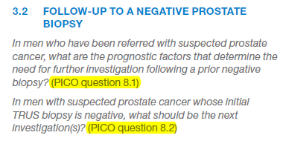
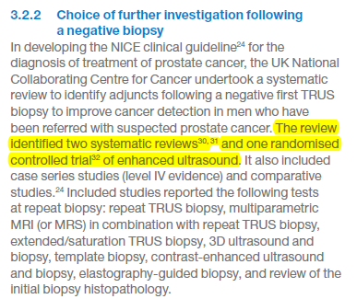
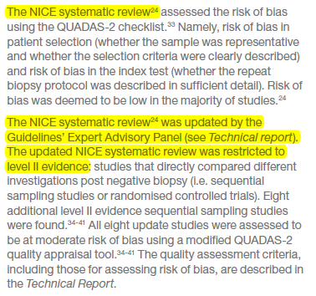
Prostate Cancer Foundation of Australia and Cancer Council Australia PSA Testing Guidelines Expert Advisory Panel. Draft clinical practice guidelines for PSA testing and early management of test-detected prostate cancer. Prostate Cancer Foundation of Australia and Cancer Council Australia, Sydney (2016).
In men with suspected prostate cancer whose initial TRUS biopsy is negative, what should be the next investigation(s)?

Slide 44
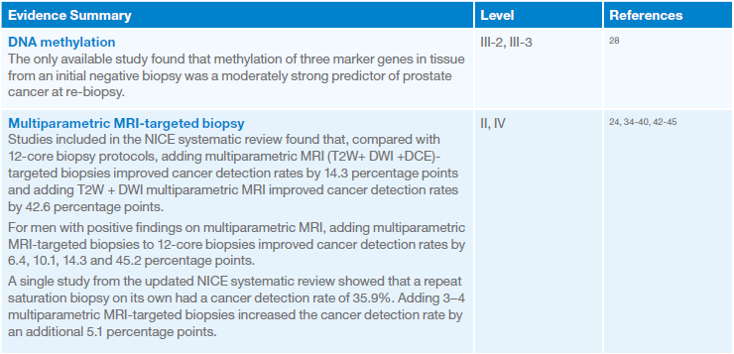
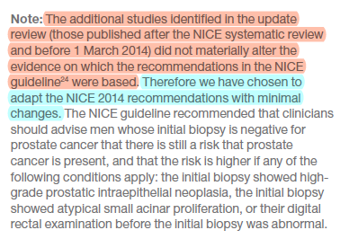
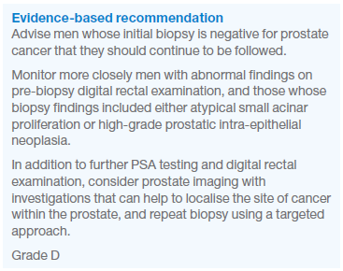
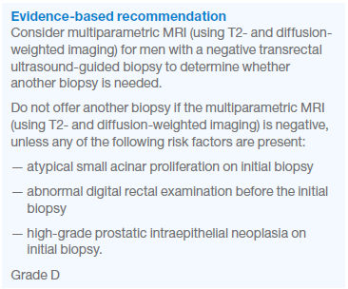
In men with suspected prostate cancer whose initial TRUS biopsy is negative, what should be the next investigation(s)?

Slide 45
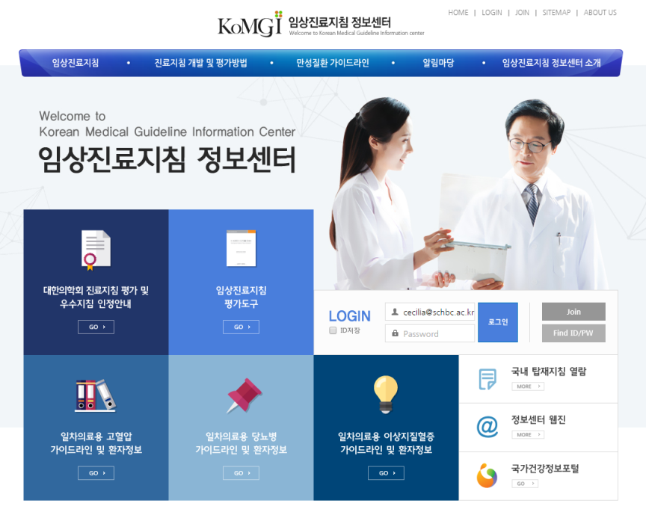
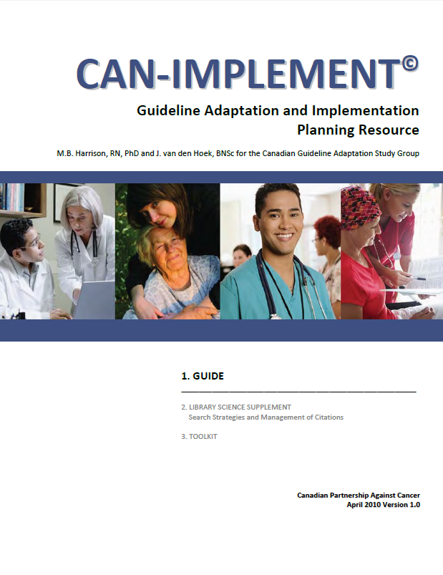
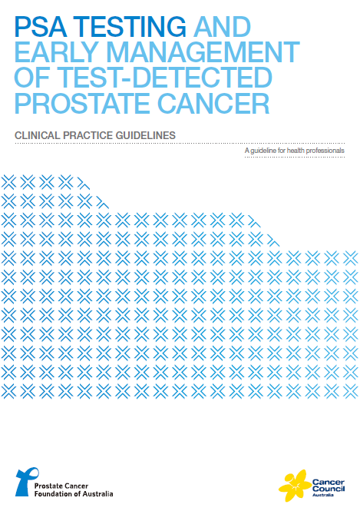
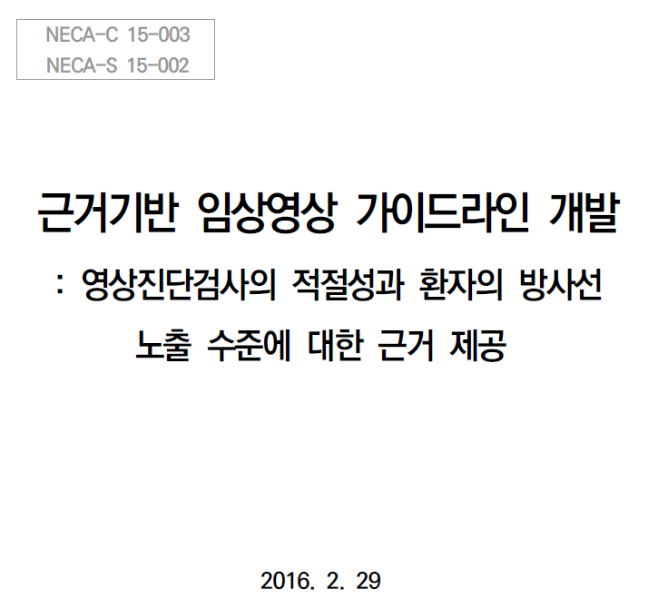
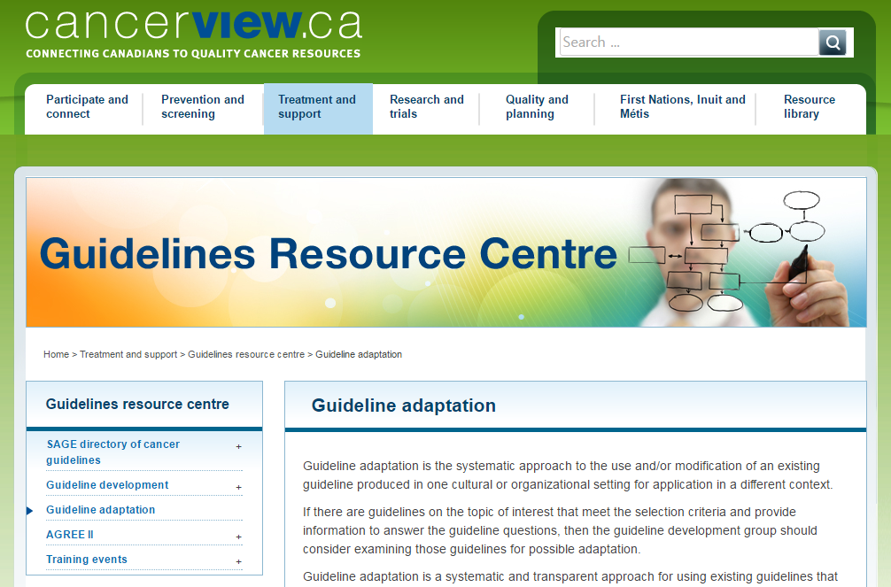



Slide 46

경청해 주셔서 감사합니다.
Haleakala, Nov. 18, 2016

